Slide 1



SEJONG UNIVERSITY
STUDENT EXCHANGE WEBPAGE
For students, teachers, and staff
GROUP 3

Slide 2

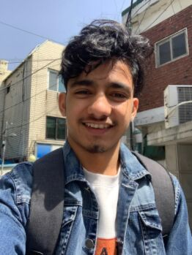
MEET THE DEV TEAM
NG. HONG PHUC
LEADER
GAUTAM BOHARA
TEAM MEMBER

Slide 3


PRESENTATION DETAILS
Overview of Project
Features & Explanation
Futute Improvements
Q&A

Slide 4
OVERVIEW OF THE PROJECT
REASONS & CONTENTS

Slide 5

REASONS
MANY EXCHANGE STUDENTS.
NO PROPER WEBSITE TO FIND SPECIFIC INFORMATION.
INCREASE UNIVERSITY QUALITY & PRESTIGE.
GROUP 3

Slide 6
CONTENTS
BASIC INFORMATION (SEJONG MAIN WEBPAGE)
SECRET THINGS (DORMITORY, LIFE AT SEJONG)
STUDENT REAL EXPERIENCE
LIFE IN SEOUL

Slide 7
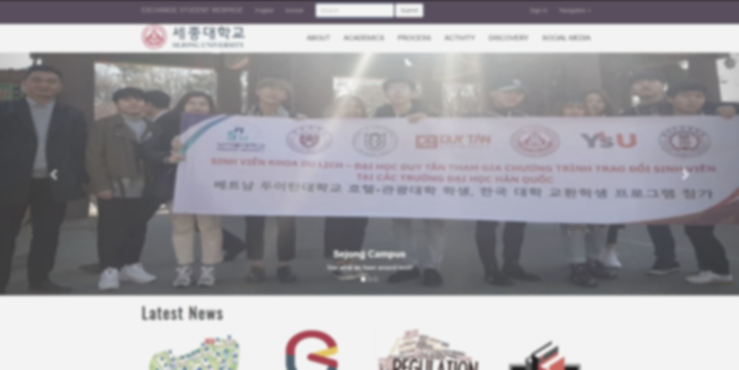
Welcome to our webpage

Slide 8
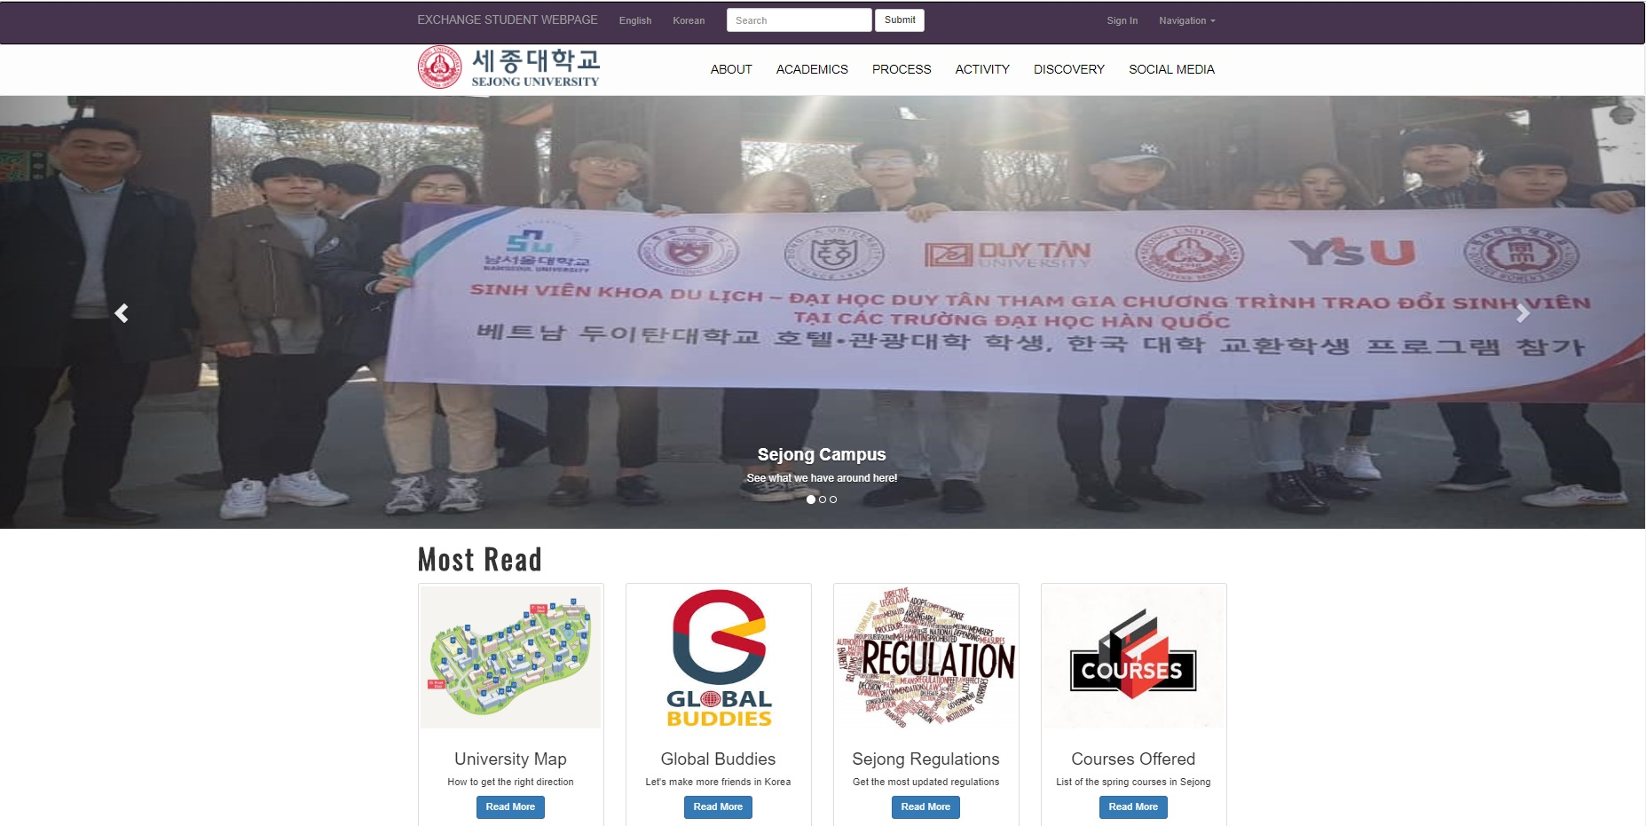
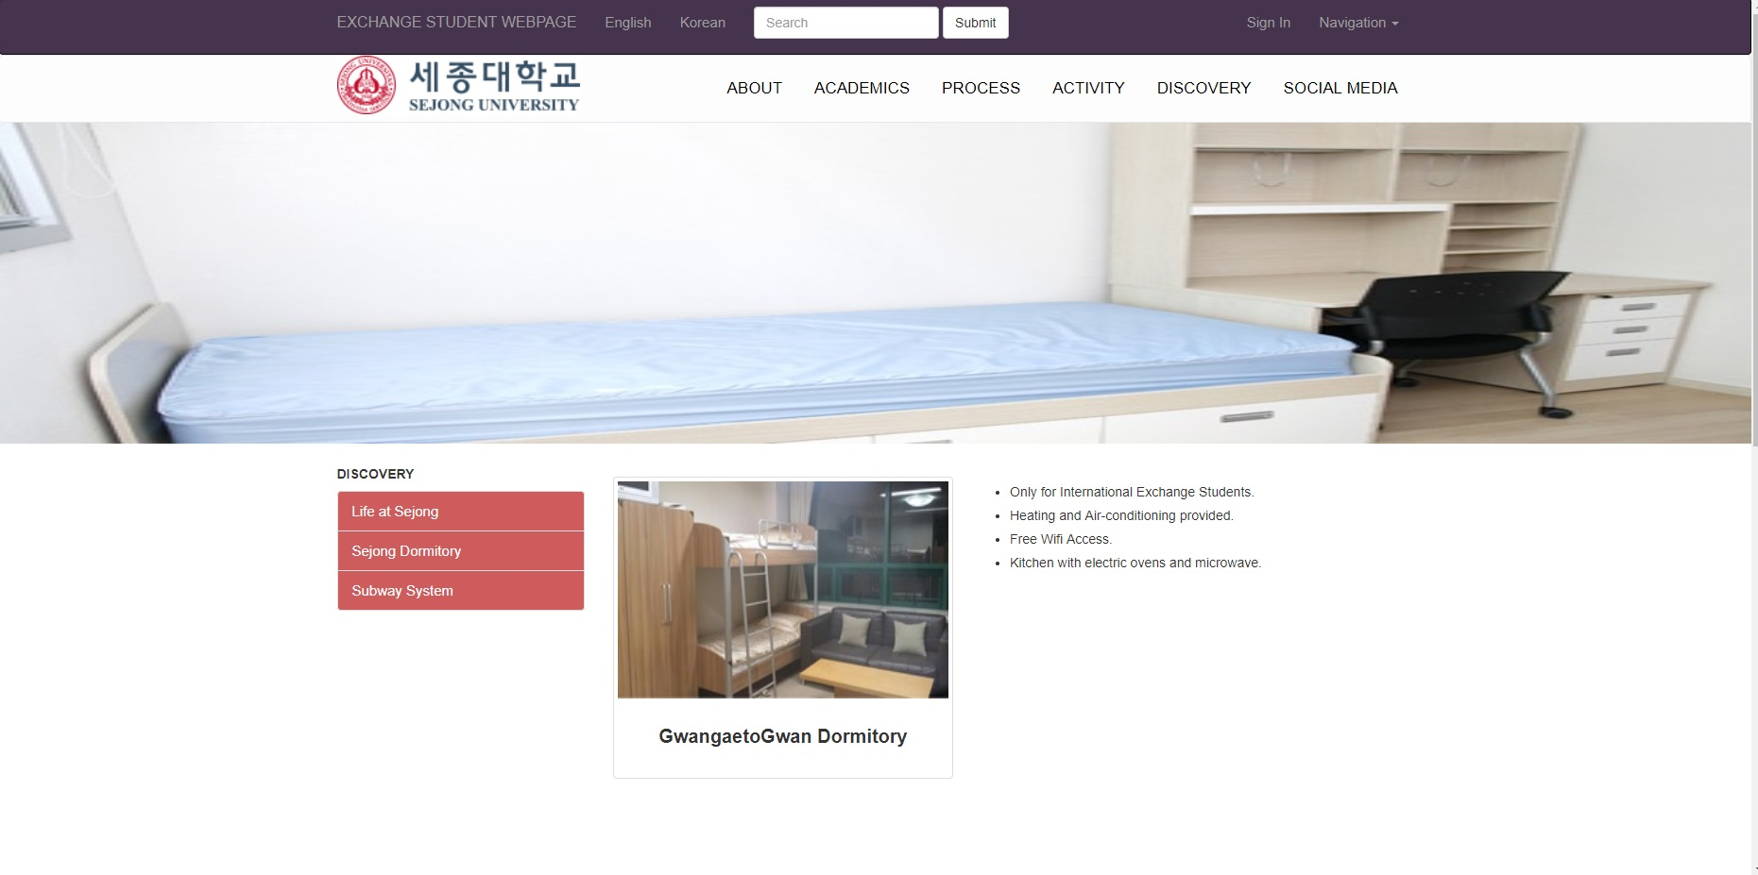
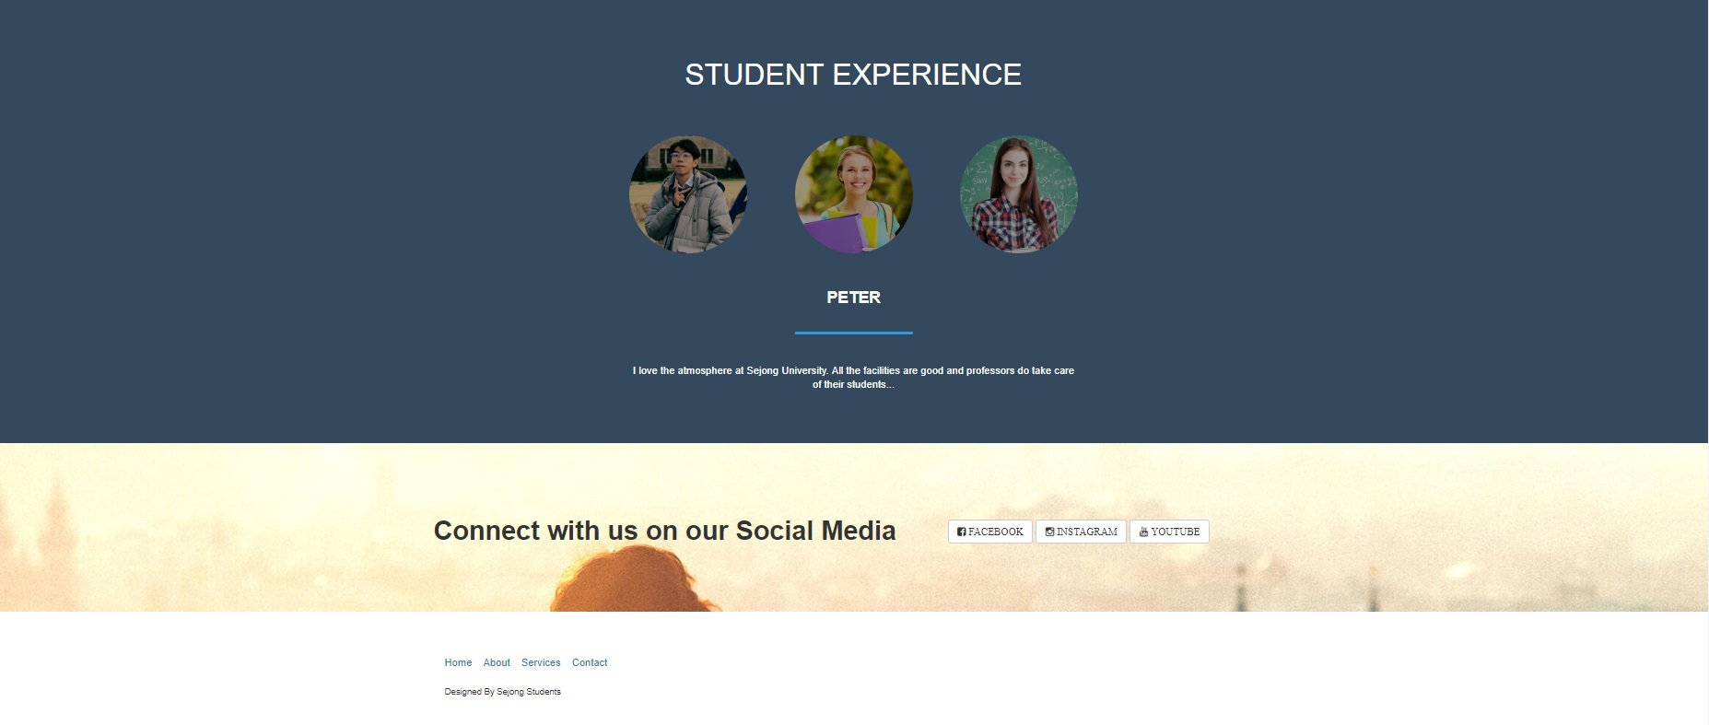

Slide 9

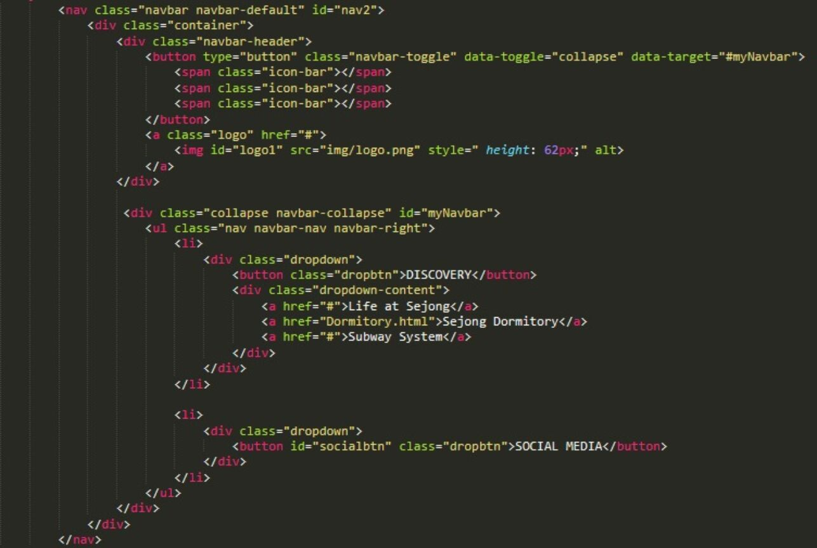
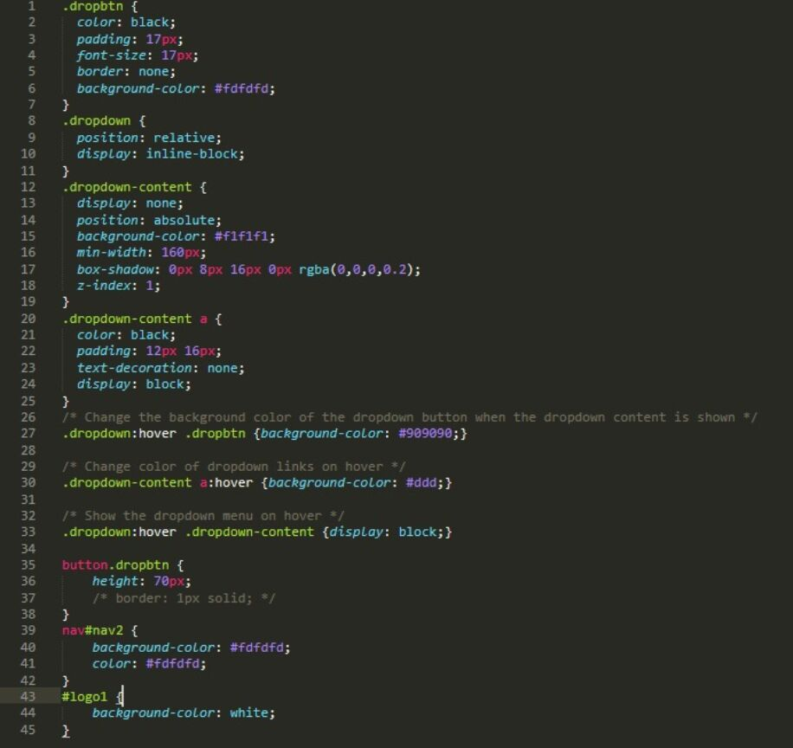
NAVIGATION BAR

Slide 10
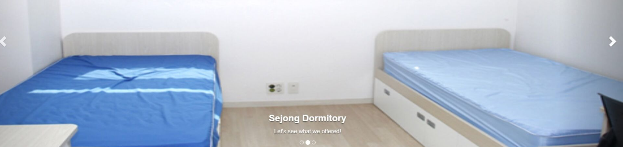
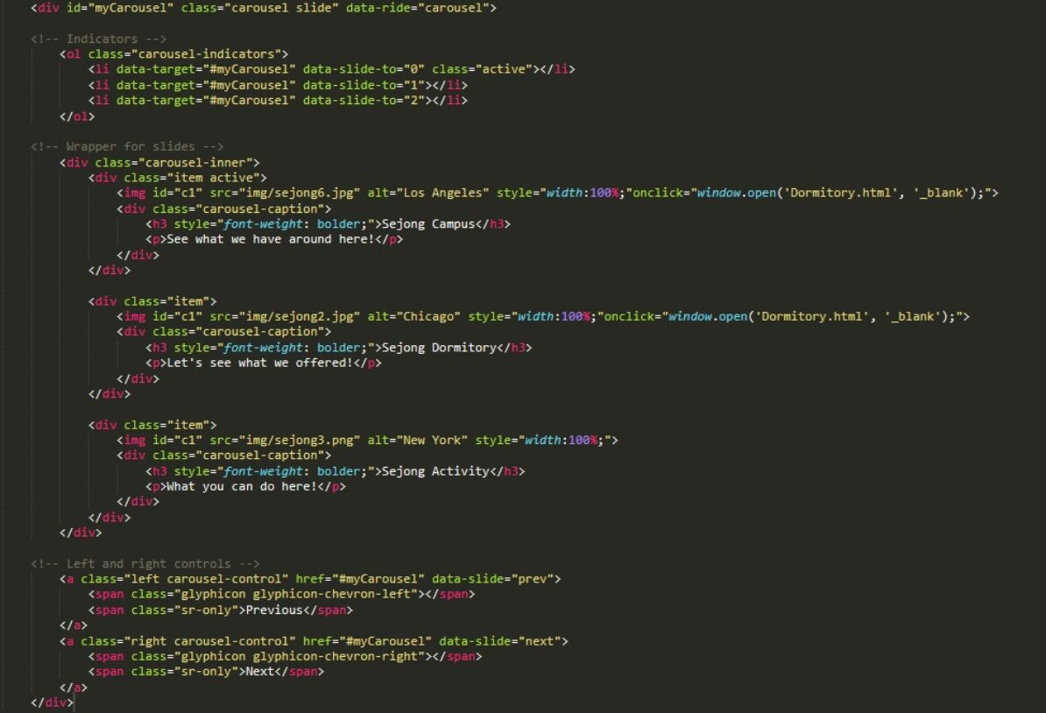
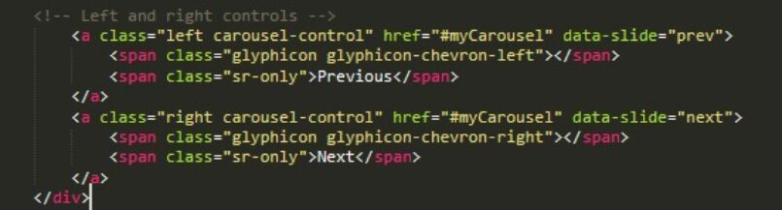
CAROUSEL FOR DISPLAYING IMAGE

Slide 11
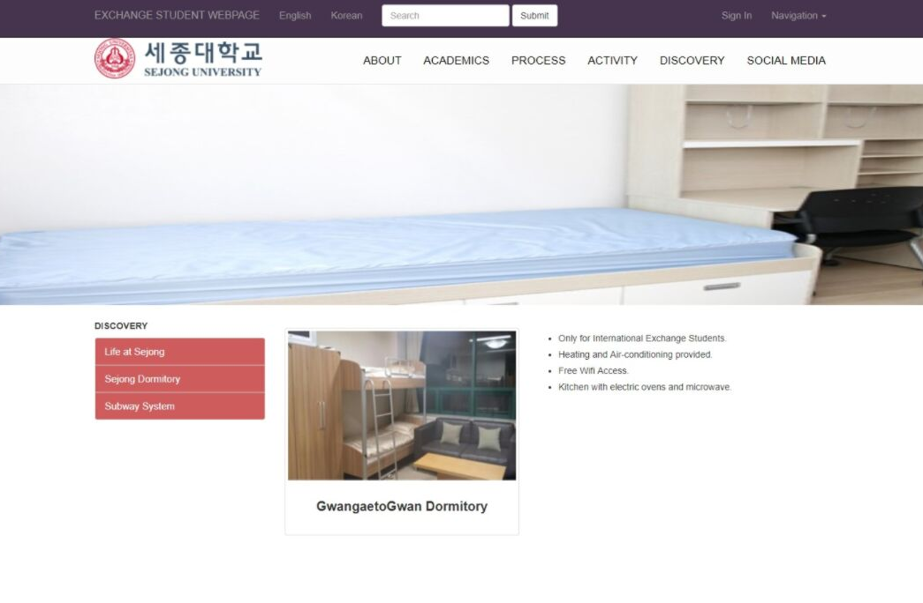
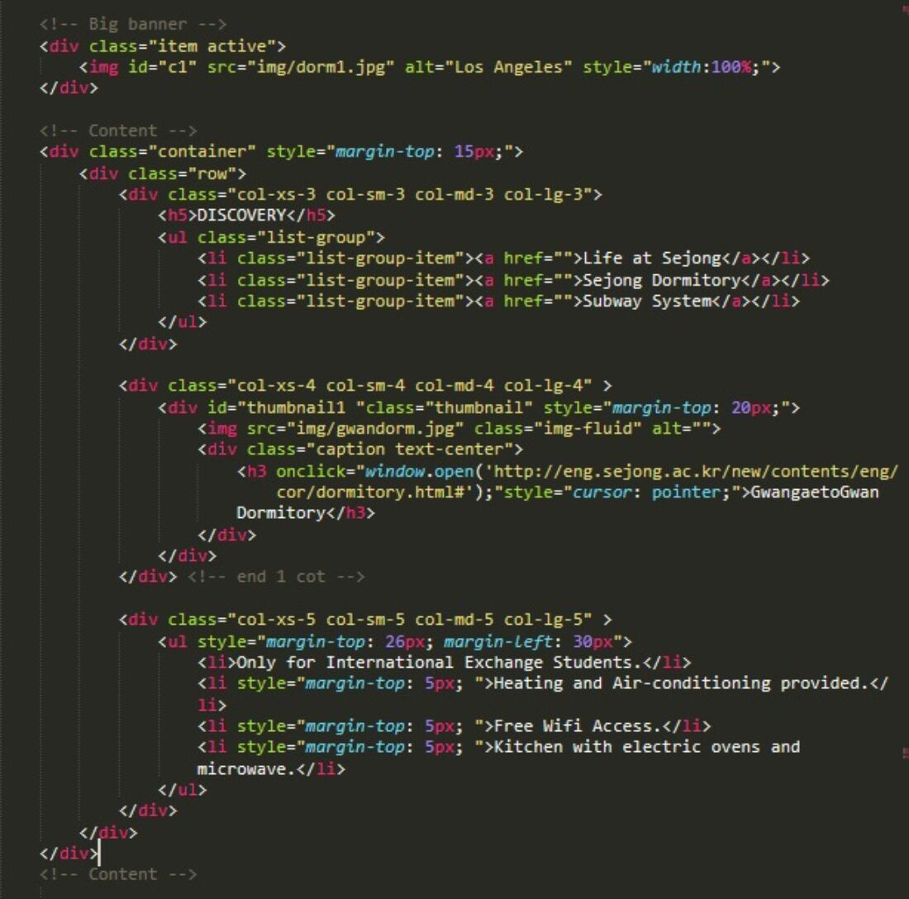
DORMITORY PAGE

Slide 12

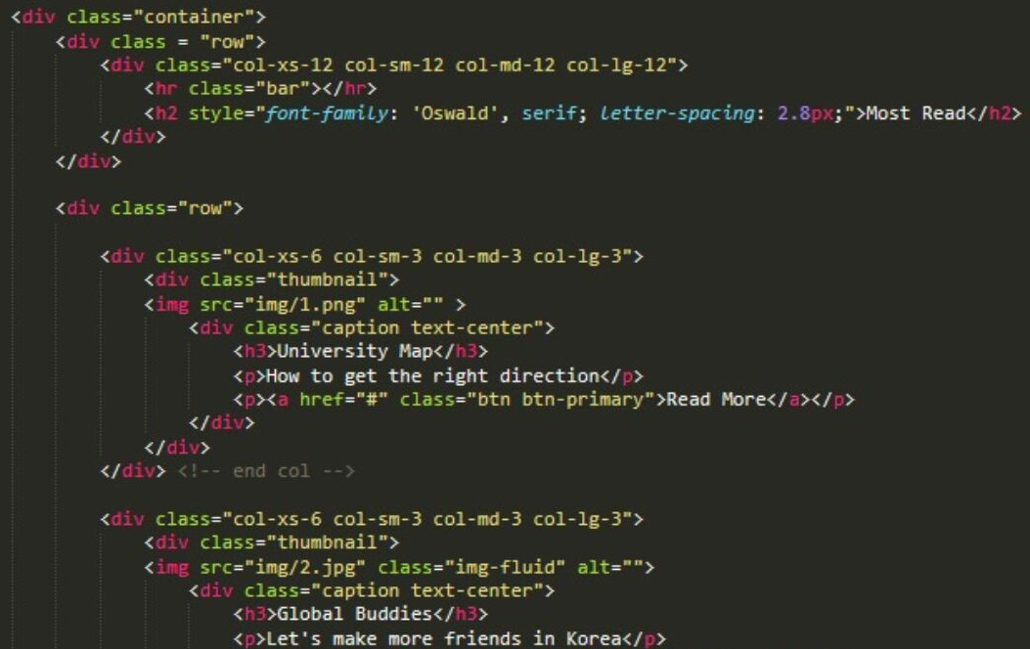
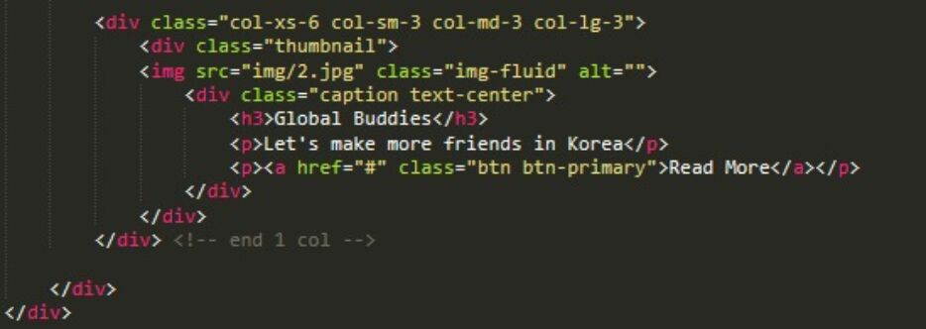
MOST READ STORIES

Slide 13

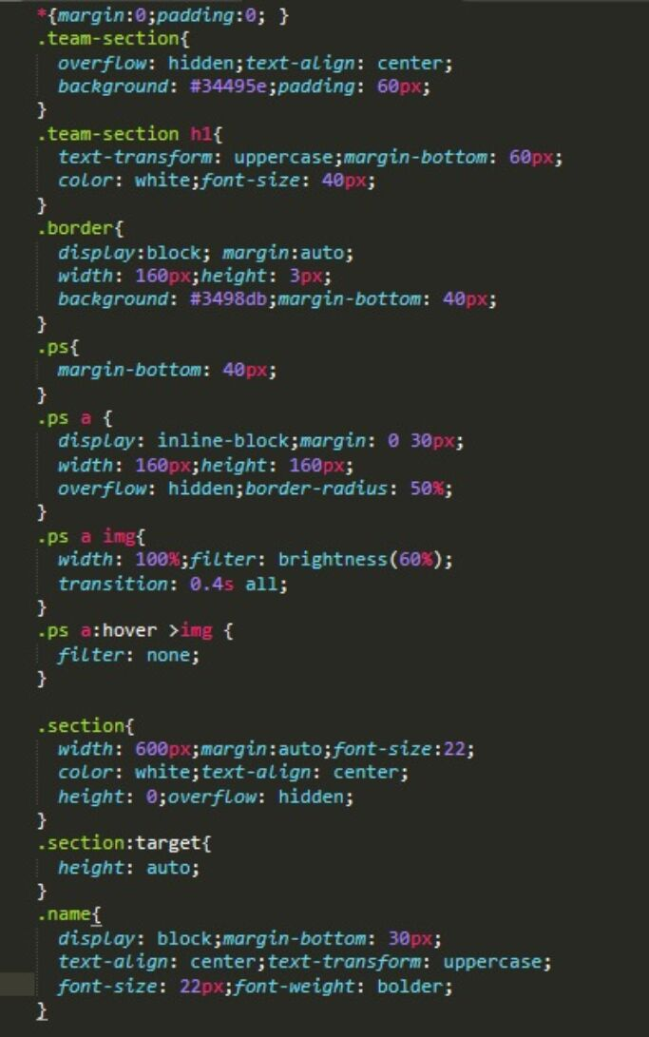
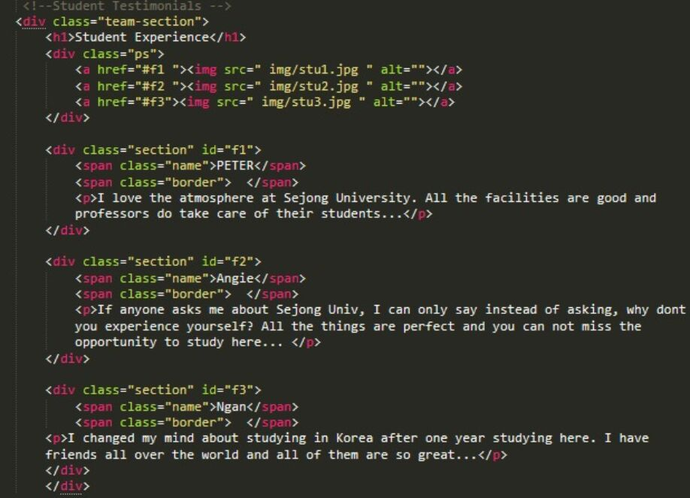
STUDENT EXPERIENCE

Slide 14
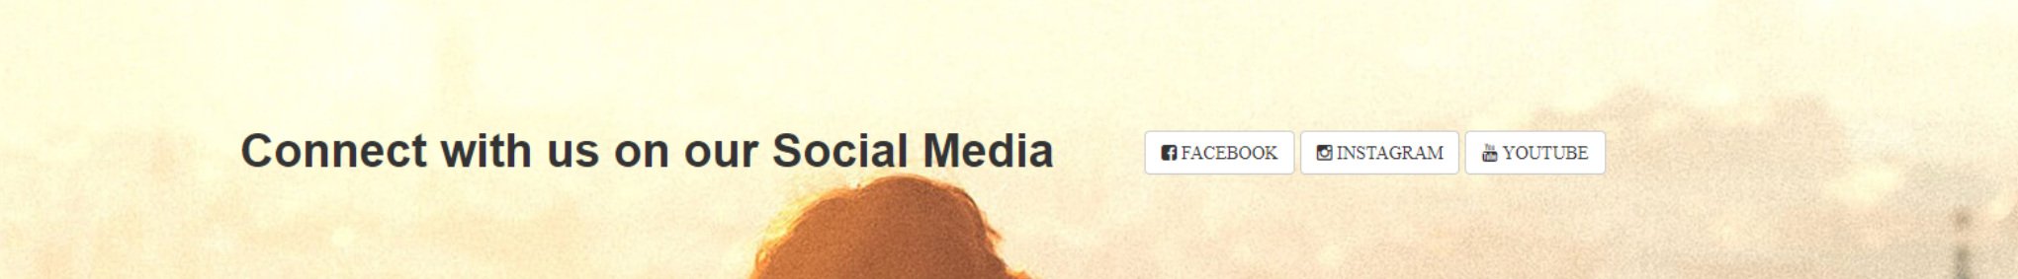
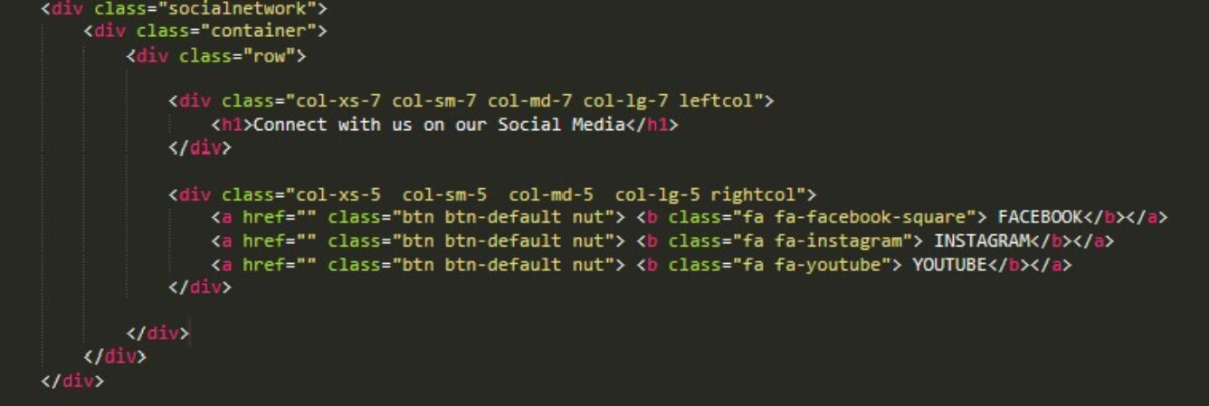
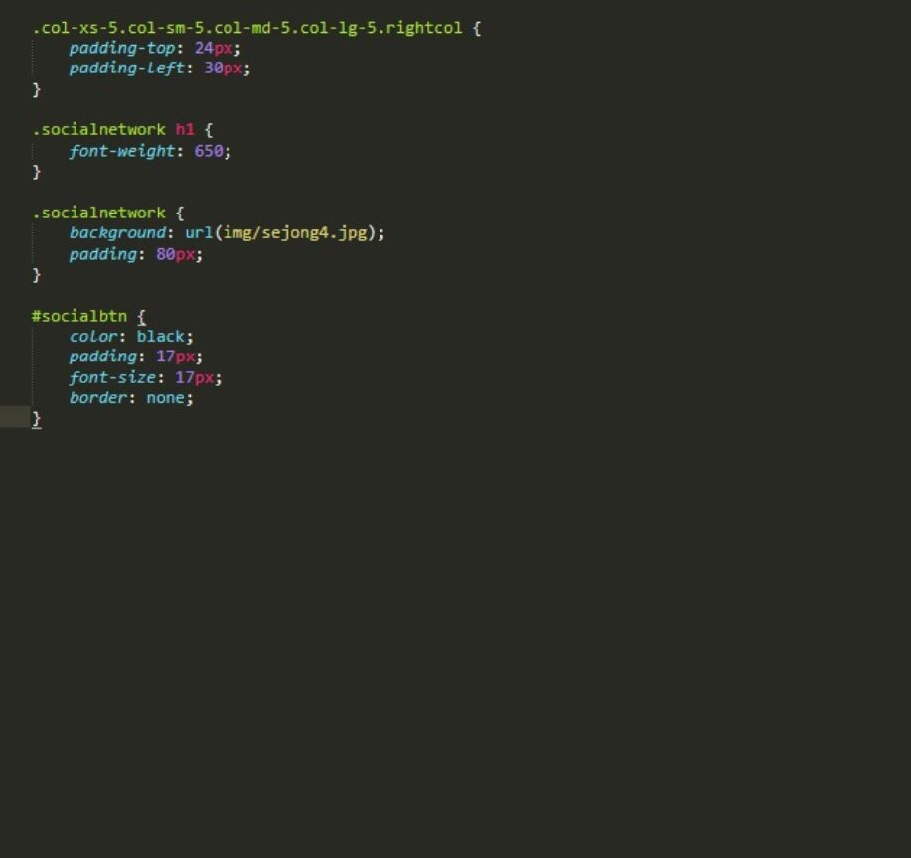
Phần giữ chỗ văn bản
SOCIAL MEDIA

Slide 15


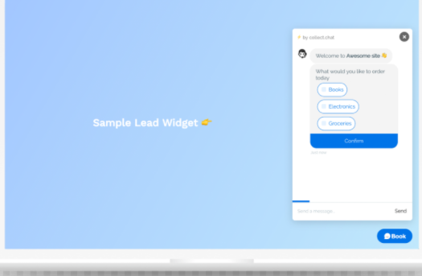
FUTURE IMPROVEMENTS
UI/UX
LOGIN
CHATBOT
Enhace User Interface Design & User Experience.
Users can create & access their account, then make their own schedule, share their experience directly.
Increase interaction between users and page.

Slide 16

THANKS FOR YOUR ATTENTION!

